Slide 1
SMART PARKING PHASE-2

Slide 2
Problem Statement:
In recent research in metropolitan cities the parking management problem can be viewed from various angles such as high vehicle density on roads. This results in annoying issues for the drivers to park their vehicles as it is very difficult to find a Parking slot. The drivers usually waste time and effort in finding parking space and end up parking Their vehicles finding a space on the street which further leads to space congestion. In Worst case, people fail to find any parking space especially during peak hours and Festive season.

Slide 3
Project Planning:
Implementation of the proposed system.
To study Software & Hardware components.
Experimental setup of proposed design.
Checking the output by writing appropriate code.
Result & Discussion.

Slide 4
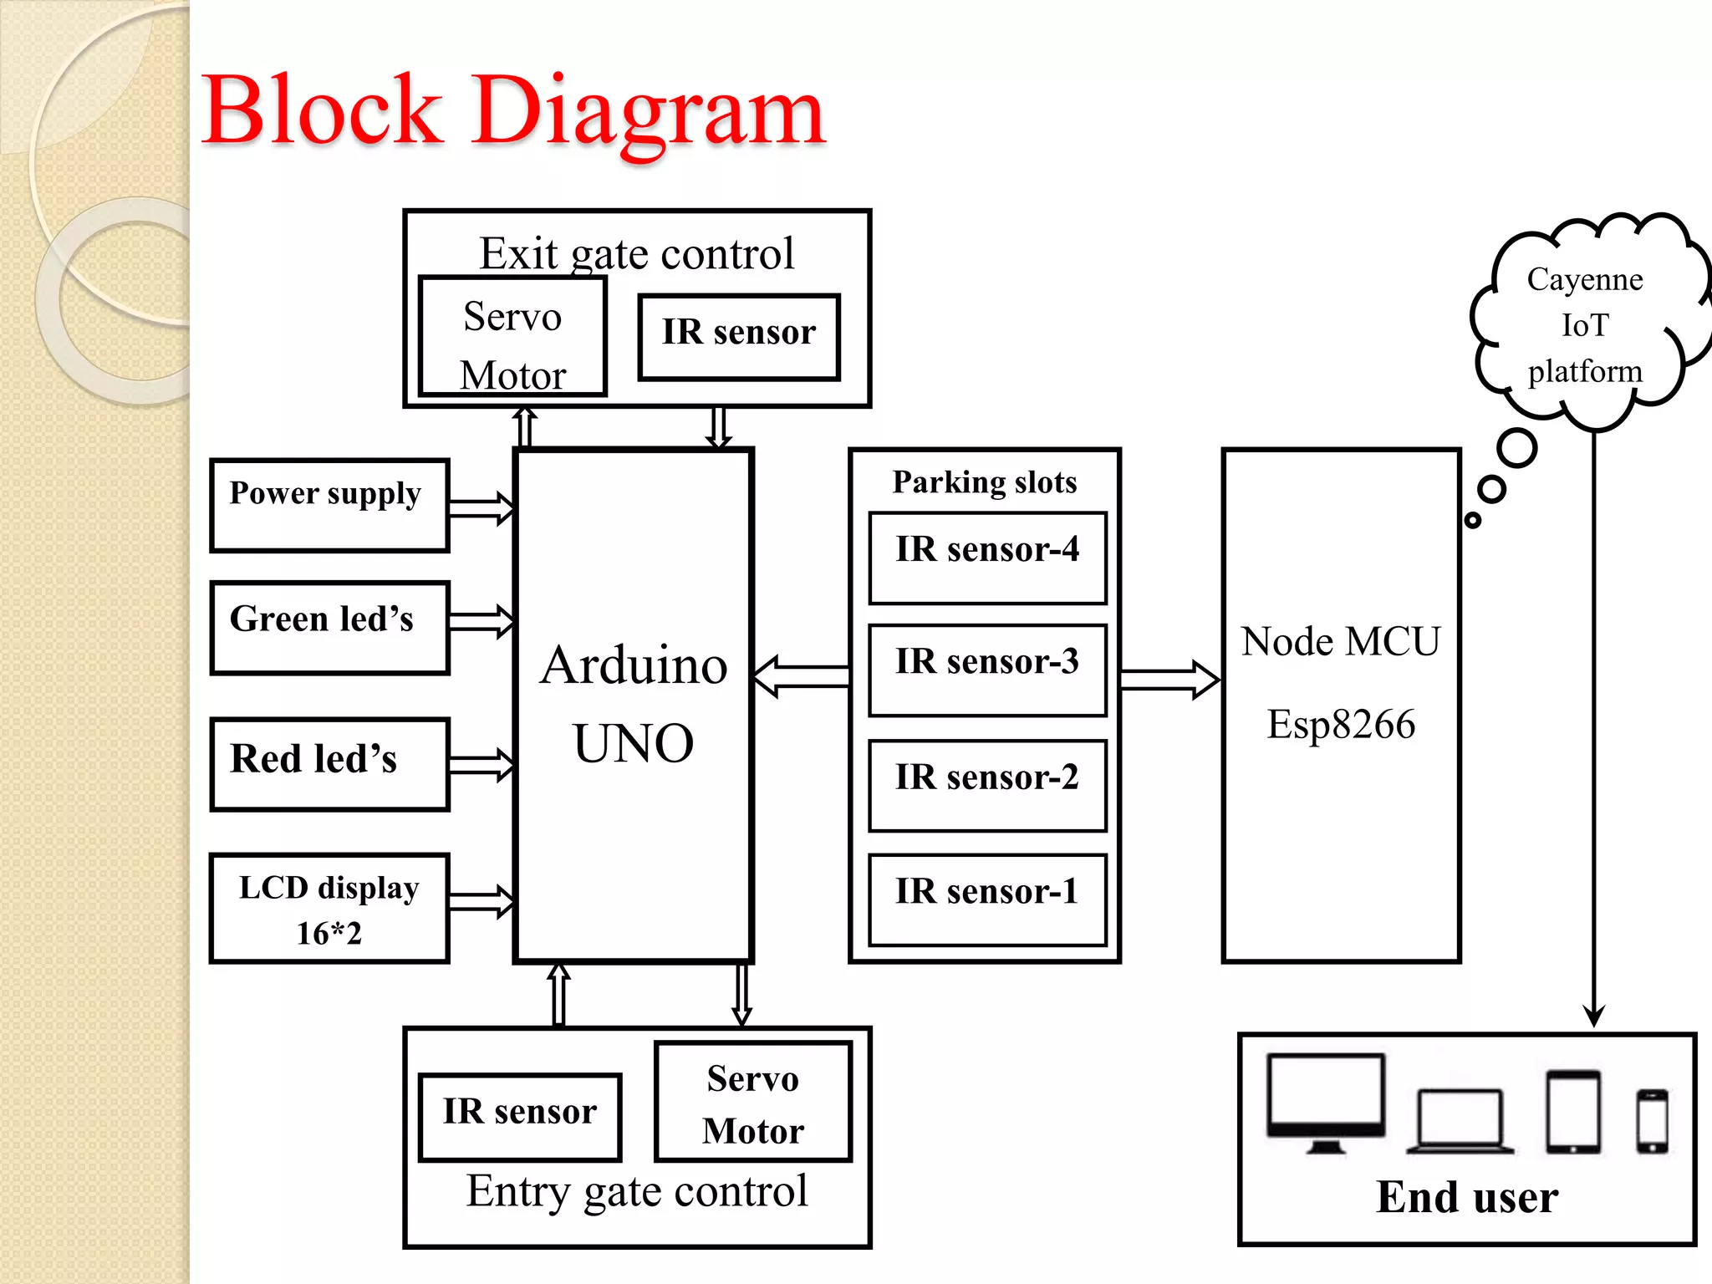
Block Diagram:

Slide 5
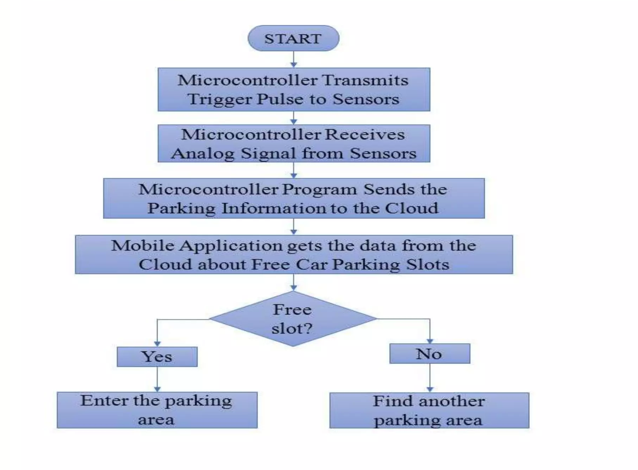
Flow Chart:

Slide 6
WORKING:
Step-1:
when car enters the parking area IR sensor that is present before
IN gate will detects the passing vehicle and the gate will be opened
automatically.
Step-2:
The car will enter into the parking area at that time person doesn’t
know which slot is empty, for this there will be an indication of LED’s for every slot when the Green light glows the slot is empty when the red light glows the slot was filled. By this the person easily know which slot is empty.

Slide 7
Step-3:
The operation of exit side will be same as that of the entrance.
When the car is leaving the parking area,the IR sensor that is present
before the OUT gate will detect the passing vehicle and the gate will be
opened automatically.
Step-4:
In front of the parking area,there will be an LCD display that is used
to show the status of the parking slots, whether the parking is available
or not.

Slide 8
Step-5:
The main advantages of the current system is the user will register in CAYENNE application/ website. From this application/ website also the user can see the status of parking area. In this application it will show the information of parking slots individually.

Slide 9
Advantages:
Shorter waiting time at parking place.
It saves fuel, money, space and time.
Reduced pollution.
Reduced traffic.
Carbon emission is reduced.
Efficiency.

Slide 10
Applications:
The smart car parking system can be implemented in
Shopping malls ..
Restaurants
Theatres

Slide 11
Conclusion:
This project focuses on implementation of car parking place detection using Internet of Things.
The system benefits of smart parking go well beyond avoiding time wasting.
Developing a smart parking solutions with in a city solves the pollution problem.

